Slide 1


Noida Institute of Engineering and Technology, Greater Noida
Science, Management and Indian Knowledge System
(Unit-IV)
Unit: 4
ESSENCE OF INDIAN TRADITIONAL KNOWLEDGE
(AMICANC0502 )
Ms. Neha singh
Assistant Professor
MCA VI semester

Slide 2
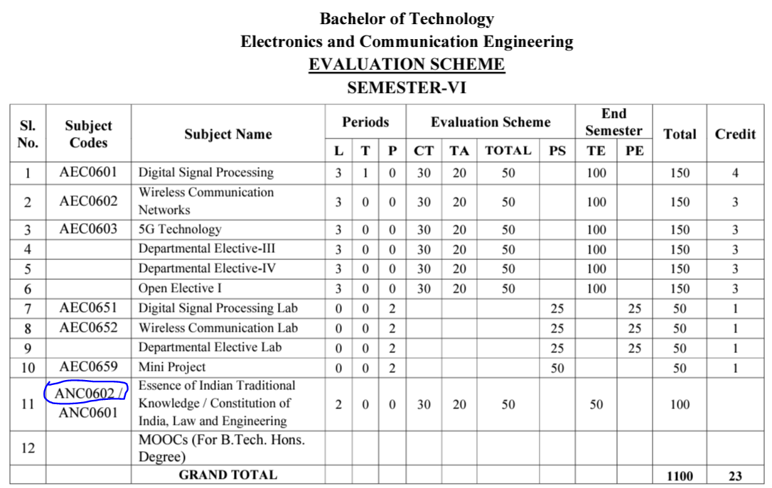
Evaluation Scheme (EC-6th Semester)

Slide 3
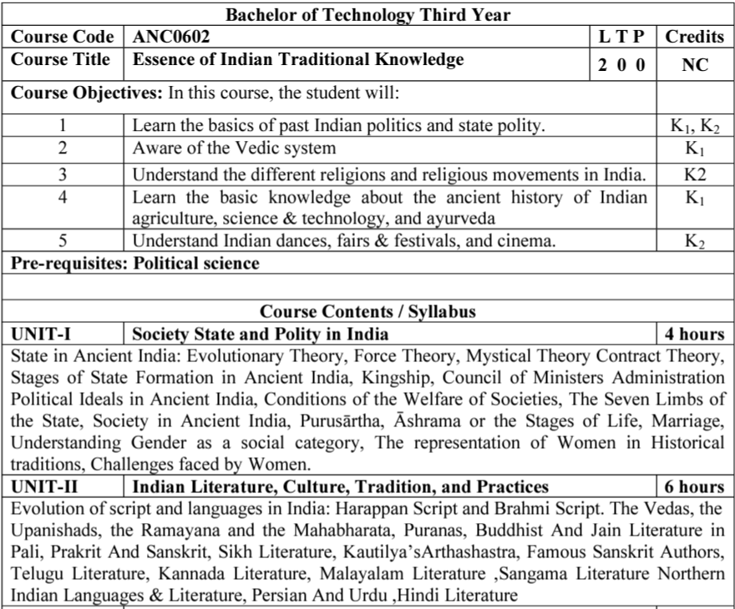
Syllabus

Slide 4
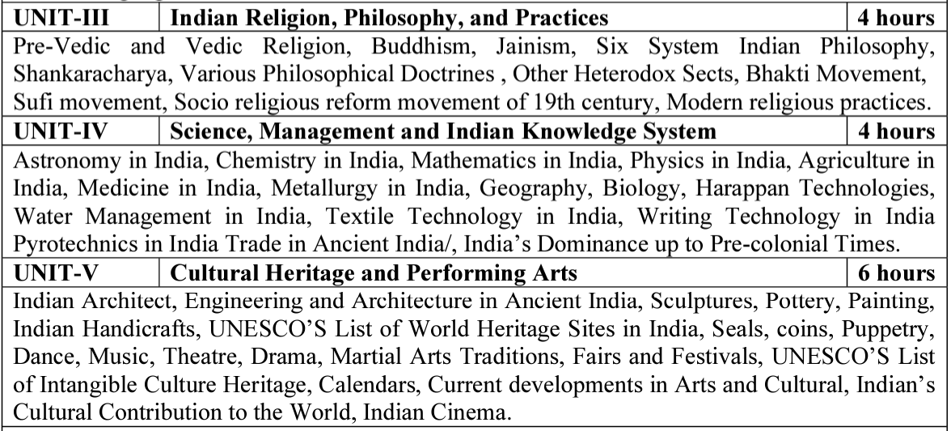
Syllabus(Continue….)

Slide 5
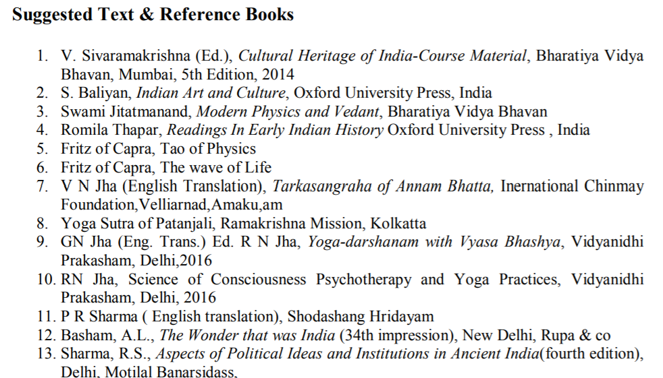
Text Books

Slide 6
Applications of Essence of Indian Traditional Knowledge
Can apply the old designing concept with blend of new trends in building construction
Learn the ancient living style
Indian Traditional knowledge modern scientific perspective
Apply the ancient advanced architectural wonders in current trends

Slide 7
Course Objective
Course Objectives:
The student will try to learn about:
To imparting the basic principles of thought process, reasoning and inference to identify the roots and details of some of the contemporary issues faced by our nation and try to locate possible solutions to these challenges by digging deep into our past.
To enable the students to understand the importance of our surroundings and encourage the students to contribute towards sustainable development.

Slide 8
Course Objective(Continue…)
To sensitize students towards issues related to ‘Indian’ culture, tradition and its composite character.
To make students aware of holistic life styles of Yogic-science and wisdom capsules in Sanskrit literature that are important in modern society with rapid technological advancements and societal disruptions.
To acquaint students with Indian Knowledge System, Indian perspective of modern scientific world-view and basic principles of Yoga and holistic health care system.

Slide 9
Course Outcome
At the end of this course students will able to:
CO1: Understand the basic principles of thought process & inference to identify the roots and details of some of the contemporary issues faced by our nation and try to locate possible solutions to these challenges by digging deep into our past.
CO2: Illustrate the importance of our surroundings and encourage the students to contribute towards sustainable development.
CO3: Interpret the issues related to ‘Indian’ culture, tradition, & its composite character.

Slide 10
Course Outcome (Continue…)
CO4: Aware of holistic life styles of Yogic-science and wisdom capsules in Sanskrit literature that are important in modern society with rapid technological advancements and societal disruptions.
CO5: Acquaint students with Indian Knowledge System, Indian perspective of modern scientific world-view and basic principles of Yoga and holistic health care system.

Slide 11
Program Outcomes
Program Outcomes are narrow statements that describe what the students are expected to know and would be able to do upon the graduation.
These relate to the skills, knowledge, and behavior that students acquire through the programmed.
Engineering knowledge
Problem analysis
Design/development of solutions
Conduct investigations of complex problems
Modern tool usage
The engineer and society
Environment and sustainability
Ethics
Individual and team work
Communication
Project management and finance
Life-long learning

Slide 12
Program Specific Outcomes
Program Specific Outcomes (PSOs) are what the students should be able to do at the time of graduation. The PSOs are program specific. PSOs are written by the department offering the program.
On successful completion of B. Tech. (EC) Program, the Electronics and Communication engineering graduates will be able to:
PSO1: To apply the knowledge of mathematics, science and electronics & communication engineering to work effectively in the industry based on same or related area.
PSO2: To use their skills to work in modern electronics & communication engineering tools, software and equipments to design solutions for complex problems in the related field that meet the specified needs of the society.
PSO3: To function effectively as an individual and as a member or leader of a team by qualifying through examinations like GATE (Graduate Aptitude Test in Engineering), IES (Indian Engineering Services), PSUs (Public Sector Undertakings), TOEFL (Test of English as a Foreign Language), GMAT (Graduate Management Admission Test) and GRE (Graduate Record Examinations in US) etc.

Slide 13
CO-PO and PSO Mapping
CO | PO1 | PO2 | PO3 | PO4 | PO5 | PO6 | PO7 | PO8 | PO9 | PO10 | PO11 | PO12 | PSO1 | PSO2 | PSO3
CO1 | - | - | - | - | - | - | - | 3 | - | - | - | 3 | - | - | -
CO2 | - | - | - | - | - | - | - | 3 | - | - | - | 3 | - | - | -
CO3 | - | - | - | - | - | - | - | 3 | - | - | - | 3 | - | - | -
CO4 | - | - | - | - | - | - | - | 3 | - | - | - | 3 | - | - | -
CO5 | - | - | - | - | - | - | - | 3 | - | - | - | 3 | - | - | -
Avg | - | - | - | - | - | - | - | 3 | - | - | - | 3 | - | - | -
*3= High *2= Medium *1=Low

Slide 14
Program Educational Objectives
The Program Educational Objectives (PEOs) of an engineering degree program are the statements that describe the expected achievements of graduates in their career, and what the graduates are expected to perform and achieve during the first few years after graduation.
PEO1: To have an excellent scientific and engineering breadth so as to comprehend, analyze, design and solve real-life problems using state-of-the-art technology.
PEO2: To lead a successful career in industries or to pursue higher studies or to understand entrepreneurial endeavours.
PEO3: To effectively bridge the gap between industry and academics through effective communication skill, professional attitude and a desire to learn.

Slide 15
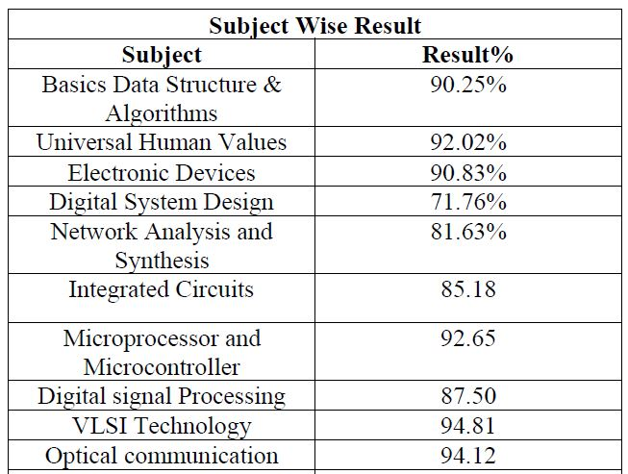
Result Analysis
Faculty Name | Subject Code | Section A | Section B
Mr. Anshu Kumar | ANC 0602 | 100 % | 100 %

Slide 16
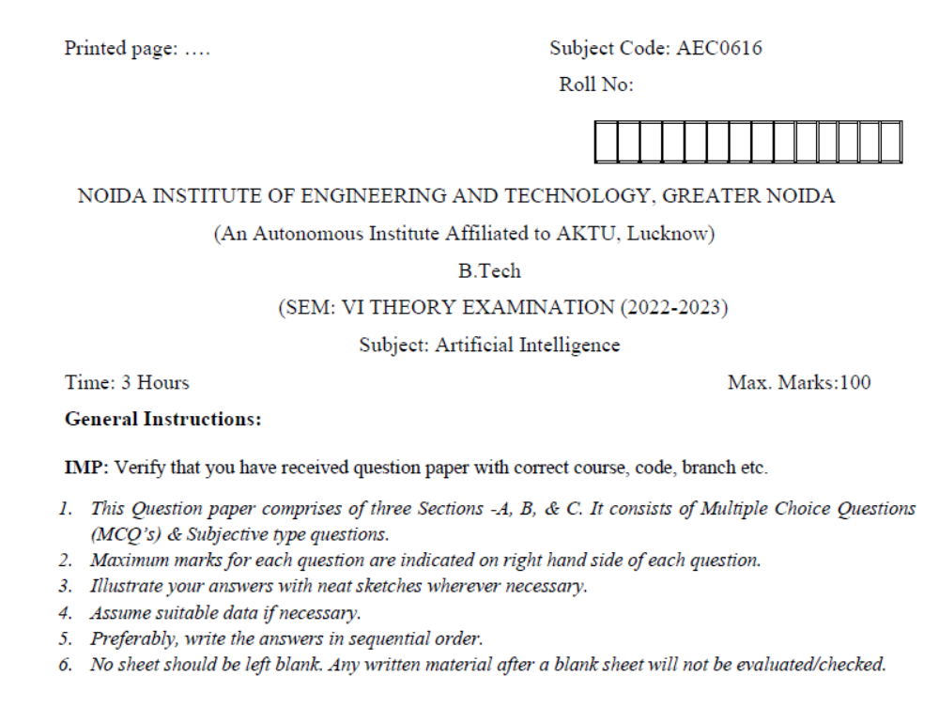
Question Paper Template

Slide 17
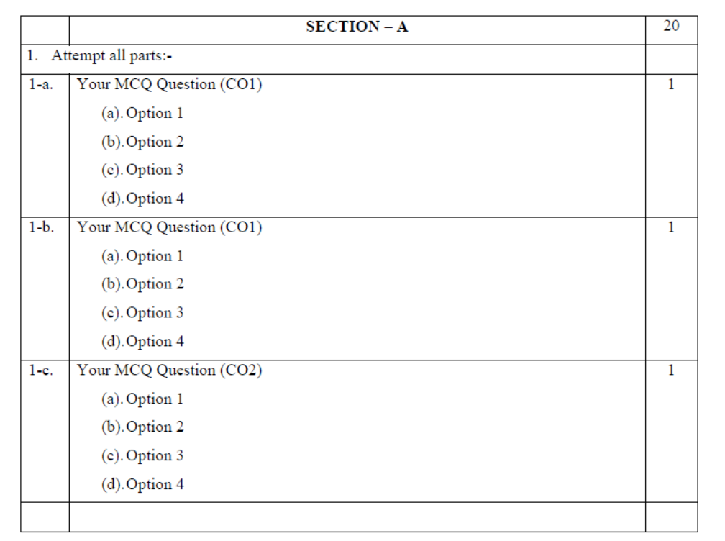
Question Paper Template (Cont……)

Slide 18
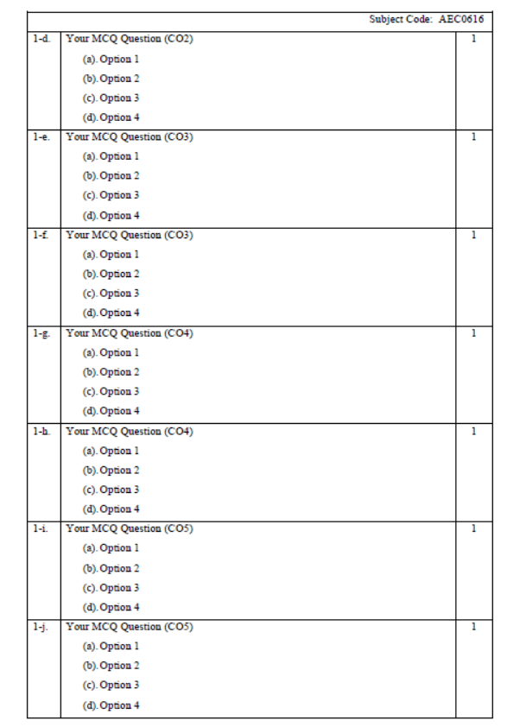
Question Paper Template (Cont……)

Slide 19
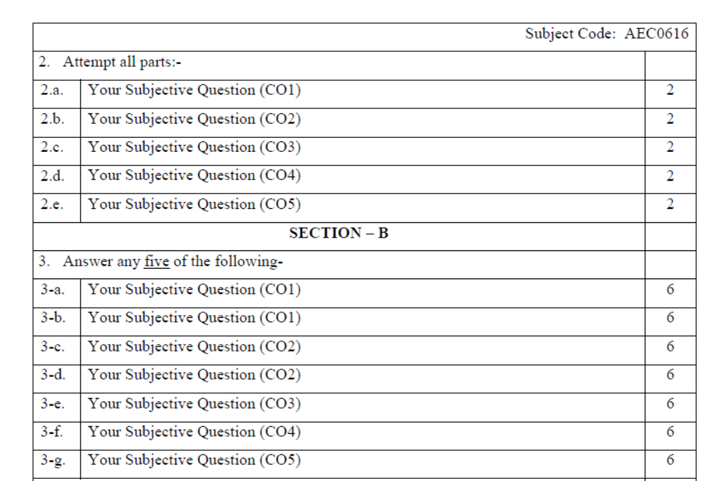
Question Paper Template (Cont……)

Slide 20
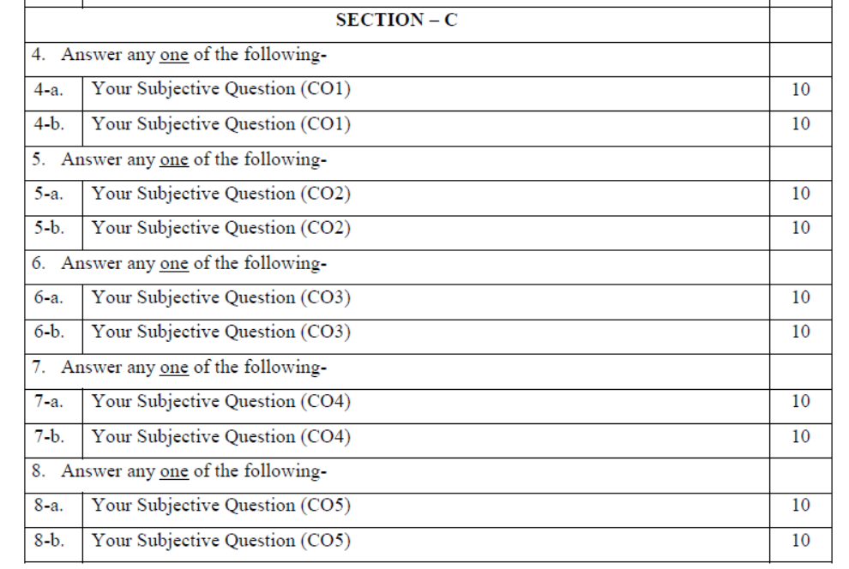
Question Paper Template (Cont……)

Slide 21
Prerequisite and Recap
Basic knowledge of Indian traditions, culture & society.

Slide 22
Brief Introduction about the subject with Video
The course aims at imparting basic principles of thought process, reasoning and inference & to identify the roots and details of some of the contemporary issues faced by our nation and try to locate possible solutions to these challenges by digging deep into our past. To enable the students to understand the importance of our surroundings and encourage the students to contribute towards sustainable development. To sensitize students towards issues related to ‘Indian’ culture, tradition and its composite character.
https://www.youtube.com/watch?v=jgQlf3DM_GU&t=625s

Slide 23
Content
Astronomy in India,
Chemistry in India & Mathematics in India,
Physics in India, Agriculture in India,
Medicine in India,
Metallurgy in India,
Geography, Biology,
Harappan Technologies & Water Management in India,
Textile Technology in India & Writing Technology in India
Pyrotechnics & India Trade in Ancient India,
India’s Dominance up to Pre-colonial Times

Slide 24
Module 5 Objective
To make students aware of holistic life styles of Yogic-science and wisdom capsules in Sanskrit literature that are important in modern society with rapid technological advancements and societal disruptions.

Slide 25
Topic Objective
Topic No. | Topic Objective
1 | To study the Astronomy in India and Chemistry in India
2 | To study the Mathematics, Physics and Agriculture in India

Slide 26
Topic Mapping
S.No. | Topic | Course Outcome
1 | Astronomy in India, Chemistry in India | CO4
2 | Mathematics, Physics , Agriculture in India | CO4

Slide 27
Astronomy in India (CO4)
Astronomy is the study of objects seen in the sky.
The earliest reference of Indian interest in the field of astronomy has been found in Taittiriya Brahmana. It makes a mention of Sun, Moon, Nakshatras and seasons. There is a reference of rules of making a panchanga in vedanga jyotisha.
Vedic people knew Jupiter and Venus. In Mahabharata Mercury, Mars and Saturn are mentioned.
Real development in the field of astronomy began in around 500 AD.
The first person to make significant contribution to it was Aryabhata (476 AD-550 AD) who wrote a book titled Aryabhatiyam.

Slide 28
Astronomy in India (CO4)
Āryabhaṭṭa: Āryabhaṭṭa is one of the most well-known ancient Indian astronomers. He was born in 476 C.E. somewhere near modern Patna.
His work is compiled in Āryabhaṭiyam, perhaps the most influential book in the history of Indian astronomy. It is remarkable that he wrote this treatise when he was only 23 years of age. He introduced the use of large units of time, circular units of arc and units of distance.
Aryabhata estimated the circumference of earth and his estimation was very close to modern calculations. He postulated a new theory that the earth was round and that it was rotating on its own axis.
He was also the first to explain the true cause of solar and lunar eclipses.

Slide 29
Astronomy in India (CO4)
Aryabhata also put rules of planetary movement.
He was perhaps the first Indian to determine the value of pi (p) up to the first four places of decimal, 3.1416, which is quite close to the present known value.
India honoured this illustrious astronomer by naming the first Indian satellite after him.
Varahamihira (505 AD- 587 AD) was also a great astronomer in India. He wrote Brihat samahita, yogamaya, Panchasiddhantika, Laghukatha, Vivahapatal.
Varahamihira is given the credit for stating that the equinoxes shift due to precession by 50.32 seconds of arc per year.

Slide 30
Astronomy in India
Brahmagupta (598 AD-668 AD) wrote Brahmasphutasiddhanta and Khandakhadyaka. He proclaiming that all things fall to earth automatically. He said that it was a law of nature.
He emphasized that it was the nature of earth to attract things towards itself.
Bhaskara II or Bhaskaracharya (1114AD-1185 AD): contributed immensely to the science of astronomy. His major work on astronomy is contained in Siddhāntaśiromaṇi and Karaṇakutūhala, in which he compiled data on planetary positions, conjunctions and eclipses.

Slide 31
Chemistry in India
The development of Chemistry in India was in phases through experimentation. The areas of application of chemistry were:
Metallurgy (smelting of metals)
Distillation of perfumes
Making of dyes and pigments
Extraction of sugar
Production of paper
Production of gunpowder
Casting of canons, etc.

Slide 32
Chemistry in India
In India, Chemistry was called Rasayan Shastra, Rasatantra, Rasa Vidya and Rasakriya, all of which means science of liquids.
Chemical laboratories were called Rasakriya Shala and a chemist was referred to as rasadanya.
The development of metallurgy started in India from the Bronze Age. In fact, the progress from Bronze Age to Iron Age to the present owes a great contribution to developments in metallurgy.
One of the primary chemical discoveries was that of fire; it was so important for man that fire was worshipped as God.

Slide 33
Chemistry in India
In the area of smelting of metals, Indians had an expertise in extraction of metals from ore and its casting.
It is possible that India had borrowed this idea form Mesopotamia. The best evidences of Indian metallurgy are Iron Pillar of Mehrauli in Delhi and an Idol of Gautama Buddha in Sultanganj, Bihar.
They have not caught rust yet even after thousands of years later after its manufacture.
One of the famous Metallurgist and Alchemist of ancient times was Nagarjuna. He was an expert in transforming the base metals into gold.

Slide 34
Chemistry in India
Another treatise Rasaratnakara (a book on chemistry) mainly deals with preparation of liquids (mainly mercury).
The book also emphasised on the survey of metallurgy and alchemy.
The preservation of ancient literature was generally done on palm leaves.
After the advent of Mughals, the manufacture of gunpowder and its use in guns also started in India. Saltpeter, Sulphur and charcoal were used in different ratios to produce different varieties of gunpowder.

Slide 35
Mathematics in India
Mathematics in India
In between 1000 BC and 1000 AD, a number of treatise on mathematics were authored by Indian mathematicians which relate to the above mentioned areas.
The techniques of algebra and the concept of zero probably originated in India.
The town planning of Harappa indicates that the people in those times had a good knowledge of measurement and geometry.
The use of geometric patterns can also be found in the temples in the form of geometrical motifs.

Slide 36
Mathematics in India
The earliest book on mathematics was Shulbasutra written by Baudhayana around 6th century BC.
There is a mention of formula for the square root of 2 and even some concepts very similar to Pythagoras Theorem in the Shulbasutra. It also contains geometry related to fire altar construction.
Apastamba, in the 2nd century BC, introduced the concepts of practical geometry involving acute angles, obtuse angles and right angles.
This knowledge of angles helped in the constructions of fire altars in those times.

Slide 37
Mathematics in India
Aryabhata in around 499 AD wrote Aryabhatiya in which the concepts of mathematics as well as astronomy were explicitly mentioned.
The book written in Sanskrit, had four sections:
1. Method of calculating large units of time
2. Number theory, Geometry, Trigonometry and Bijaganita
3 and 4. On Astronomy (Jyotisa)
Brahmagupta (7th century AD) in his book Brahmasputa Siddhanta mentioned Zero as a number. In his book, he also introduced negative numbers and described them as debts and positive numbers as fortunes.

Slide 38
Mathematics in India
Salient Contribution of Aryabhata in Mathematics:
Algorithm for square root
Cube root
Place value system
Sine table
Quadratic equation
Linear indeterminate equation
Sums of squares and cubes of numbers
Plane and Spherical trigonometry

Slide 39
Physics in India
Physics in the conventional sense started in India with the pioneering work of Jagadish Chandra Bose.
His original investigations in physics date from 1895 when, as a professor of the Presidency College, Calcutta, he carried out a number of remarkable investigations on the generation of extremely short electric or radio waves having a wavelength of the order of a few millimeters and studied their properties.
Sir C.V. Raman, was a pioneer in research on optical phenomena, which eventually led in 1928 to the discovery of the effect that now bears hiss name and won him the Nobel prize in 1930.

Slide 40
Agriculture in India (CO2 & CO5)
Towards the close of the eighteenth century two events pertaining to agricultural development stood out prominently.
In 1788 the Court of Directors of the East India Company requested its representatives in India to encourage the production and improvement of cotton. Accordingly, the East India Company brought in 1793 several American cotton experts, three of whom were sent to Bombay.
Bengal grew sugar-cane profusely and exported sugar as early as 1674 to Europe through the East India Company. The Bengal product was as good as that of the West Indies.

Slide 41
Agriculture in India
The Agricultural Society of India was founded by William Carey in 1820.
The restoration of Firoz Shah’s canal on the west bank of Jamuna commenced during the administration of the Marquis of Hastings (1814-23).
The canal was so efficiently laid out that it was capable of irrigating 500,000 acres in 1870.
The Department of Revenue, Commerce and Agriculture was established in June 1871.

Slide 42
Recap
In this topic, We learned about the Astronomy in India and Chemistry in India.
We also learned about the Mathematics, Physics and Agriculture in India

Slide 43
Topic video link
YouTube/other Video Links
https://www.youtube.com/watch?v=eMzvGkasMjA
https://www.youtube.com/watch?v=afmLTcPtF9E
https://www.youtube.com/watch?v=f1Wo51X2q-c
https://www.youtube.com/watch?v=Y6phxoynC7M

Slide 44
Daily Quiz
Who among the following propounded the theory that earth is round and that it rotates on its own axis?
A. Bhaskaracharya
B. Aryabhata
C. Varahamihira
D. Brahmagupta
The Agricultural Society of India was founded in____.
A. 1790
B. 1800
C. 1820
D. 1810
Aryabhatiyam was written by Aryabhata.
A. True
B. False

Slide 45
Daily Quiz
The Agricultural Society of India was founded by______.
A. John Mill
B. William Bentick
C. William Carey
D. Curzon
The earliest reference of Indian interest in the field of astronomy has been traced from______.
A. Gopatha Brahmana
B. Taittiriya Brahmana
C. Mundaka Upnishad
D. Chandogya Upanishad
Physics started in India with the pioneering work of Jagadish Chandra Bose.
A. True
B. False

Slide 46
Daily Quiz
Brahmasputa Siddhanta was written by______.
A. Brahmagupta
B. Aryabhata
C. Varahamihira
D. Bhaskaracharya
The Department of Revenue, Commerce and Agriculture was established in June____.
A. 1873
B. 1872
C. 1871
D. 1870
In Mahabharata Mercury, Mars and Saturn are mentioned.
A. True
B. False

Slide 47
Weekly Assignment
Explain the contribution of India in Metallurgy to world in detail.
Explain the progress in Mathematics in Ancient time in India.
Explain the progress in Astronomy in Ancient time.

Slide 48
Prerequisite
Basic knowledge of Science.
Knowledge of Harappan Civilization

Slide 49
Topic Objective
Topic No. | Topic Objective
1 | To study the Medicine, Metallurgy, Geography in India
2 | To study the Biology, Harappan Technologies, Water Management, Textile Technology in India

Slide 50
Topic Mapping
S.No. | Topic | Course Outcome
1 | Medicine in India ,Metallurgy in India, Geography | CO2 & CO5
2 | Biology, Harappan Technologies, Water Management in India, Textile Technology in India | CO2 & CO5

Slide 51
Medicine in India(CO2 & CO5)
During the Vedic times, Ashwini Kumar were the practisioners of medicine and were given the divine status.
Dhanvantari was the God of Ayurveda Medicine.
Atharva Veda was the first book where a mention about the diseases, its cure and medicines can be found. According to it, the diseases were caused by the demons and spirits entering into the human body and can be cured by magical charms and spells.
Atharva Veda mentioned cure for many of the diseases which include diarrhoea, sores, cough, leprosy, fever and seizure.

Slide 52
Medicine in India
The era of practical and more rational cure to diseases emerged around 600 BC. Takshila and Varanasi emerged as the centres for medicinal learning.
The two important treaties during this time were:
1. Charak Samhita (deals with Ayurveda) by Charak, Father of
Ayurveda.
2. Sushruta Samhita (deals with Surgery) by Sushruta, Father of
Surgery.
Charak Samhita mainly deals with use of plants and herbs for medicinal purposes.

Slide 53
Medicine in India
Sushruta Samhita deals with practical problems of Surgery and Obstetrics.
Sushruta studied anatomy in great detail with the aid of a human dead body.
Ayurveda is an Upaveda of Atharvaveda.
The famous teacher Atreya taught medicine branch of medical science at Taxila University.
Hastyayurveda (Ayurveda of elephants) was a book on Veterinary science. It was authored by Palakappya.

Slide 54
Medicine in India(CO2 & CO5)
The Buddhist monks from India took the Ayurveda System to Tibet and China. The translation of the two books also took place in Arabic language.
Even the Greeks were influenced by the Indian medicines during the Indo-Greek rule in India in 180 BC-10 AD.
In the medieval period, Sarangdhara Samhita written in 13th century emphasised on the use of opium in medicines and for urine examination in laboratories.
Ras Chikitsa developed by Nagarjuna in the 2nd century AD.

Slide 55
Metallurgy in India (CO2 & CO5)
Development in the field of metallurgy can be traced back to the Harappan period. Highly developed metallurgy of Harappan is reflected in various images of copper & bronze.
Various kind of alloys like steel in India during this age. Indian steel known as wootz was world famous for its high quality and large quantity of steel was exported from India during the Ancient time.
The Mehrauli iron pillar manufactured by Chandragupta II and Sultanganj Buddha statue made of copper are the living examples of progress in the field of metallurgy in India during the Gupta age.

Slide 56
Geography (CO2 & CO5)
Geography as a branch of scientific study has developed as a consequence of man’s immediate need for functioning in the world around him.
In India the earliest references to geographical data arc found in the Rigveda.
The Puranas constitute the most detailed and comprehensive source of geographical knowledge of the post-Vedic period. They seem to have originated prior to the fifth or fourth century B.C.
Abundant evidence of the geographical knowledge of the Indian people is available in post-Vedic literature.

Slide 57
Biology (CO2 & CO5)
Plant taxonomy, the oldest of botanical disciplines, developed in India even in the Vedic period.
Later the Portuguese and Dutch, attracted by the vast potentialities of the country’s vegetation, initiated the modern study of Indian plants.
By and by the exploratory phase entered into the systematic phase and the investigations carried out by British army, medical, and forest officers resulted in the publication of several floras.
The appearance of Hooker’s masterpiece, Flora of British India, in the last decade of the nineteenth century gave a great fillip to taxonomic work.

Slide 58
Biology (CO2 & CO5)
The major landmarks of zoology in India in the nineteenth century comprise the lasting contributions of outstanding workers in the field.
The first to mention is Francis Buchanan, a native of Edinburgh, who came to India as an Assistant Surgeon in the East India Company’s service in Bengal in 1794 at the age of thirty-two. Soon after his arrival in Calcutta, Buchanan had to visit the Andaman Islands.
Hamilton Buchanan alias Francis Buchman made careful observations on fish and fisheries during his assignment to make a ‘statistical survey of Bengal and certain adjacent districts in 1806

Slide 59
Harappan Technologies (CO2 & CO5)
The Indus Valley Civilization - By the middle of the 3rd millennium BCE, a fairly developed urban culture emerged along the Indus and Saraswati rivers in the North West India.
The Indus Valley Civilization has a distinct set of features not seen anywhere else in the ancient world.
The most prominent features of the civilization were its town planning.
The archaeological excavations, both at Harappan and Mohenjo-Daro have revealed very large structures, which are interpreted to be large food grain storage buildings and are referred to as the Granaries.

Slide 60
Harappan Technologies (CO5)
The presence of these structures do provide a glimpse, howsoever hazy, of the surplus wealth at the disposal of the authority in the Indus Valley Civilisation.
Great bath where bitumen was used for waterproofing.
Harappan civilization people also used new techniques in Handicrafts, Seal carving, and metallurgy such as copper, bronze lead, and tin.
The cities of the Harappan civilization were very well planned and beautifully constructed, with baked bricks used to construct houses and buildings in rows on both sides of the road. Some houses were also built in the streets.

Slide 61
Harappan Technologies (CO2 & CO5)
Houses built in cities used to be five feet in length and 97 feet in width. Their buildings also had two-roomed houses. Some houses had private bathrooms with pottery in the walls, which also provided water drainage. In some cases, there was a provision of a crib to sit in the toilet.
In the Indus Valley Civilization, the drainage system was in very systematic order, the drainage system was used for the best convenience in every household.
The location of the water drainage from each house was made of bricks.

Slide 62
Harappan Technologies (CO5)
The Harappan civilization also built the world’s first tide port at the head of the Gulf of Cambay in Lothal, Gujarat, proving their high level of knowledge about the flow and flow of tides.
The Indus Valley Civilization was aided by major advances in transportation technology. These advances may include bullock carts that are similar to the boats seen everywhere in South Asia today.
Research published in the Journal of Archaeological Science confirms that the Indus people were the first to use complex multi-cropping strategies in both seasons, growing foods during the summer such as rice, millet, and beans etc. & in winter wheat, barley, and pulses, which required separate sorting management.

Slide 63
Harappan Technologies (CO2 & CO5)
The people of the Indus Valley civilization were technically very developed and had a good knowledge of metallurgy, they also used standardized burnt bricks, precision weights, and cotton.
Many subdivisions also had a standardized system of weights and measurements with calibration.
The people of Harappa developed some new techniques in metallurgy and also produced copper, bronze, lead, and tin.
The people of the Indus civilization had achieved great accuracy in measuring length, mass, and time. They were among the first to develop a system of equal weights and measures.

Slide 64
Harappan Technologies (CO2 & CO5)
The people of the Indus Valley Civilization practiced trephination which is a kind of medical intervention, in which a hole is made in the skull to treat skull and brain disorders.
The people of the Indus Valley were familiar with the use of wheel-drawn potters. Paintings and glazing of potters were also known. He also knew using lime as a plaster.
The earliest clear evidence of the origin of the well is found in the Mohenjo-Daro and Dholavira in ancient India (now Pakistan), the archaeological site of the Indus Valley Civilization.

Slide 65
Water Management in India (CO2 & CO5)
Archaeological evidence shows that the practice of water conservation is deep rooted in the science of ancient India.
Excavations show that the cities of the Indus Valley Civilisation had excellent systems of water harvesting and drainage.
The settlement of Dholavira, laid out on a slope between two storm water channels, is a great example of water engineering. Chanakya’s Arthashastra mentions irrigation using water harvesting systems.
Sringaverapura, near Allahabad, had a sophisticated water harvesting system that used the natural slope of the land to store the floodwaters of the river Ganga.

Slide 66
Water Management in India (CO2 & CO5)
Chola King Karikala built the Grand Anicut or Kallanai across the river Cauvery to divert water for irrigation (it is still functional) while King Bhoja of Bhopal built the largest artificial lake in India.
India has only about 4 per cent of the world’s renewable water resources but is home to nearly 18 per cent of the world’s population.
It receives an average annual precipitation of 4,000 billion cubic metres (BCM) which is the principle source of fresh water in the country.
Increasing demand from a growing population, coupled with economic activity, adds pressure on already stressed water resources.

Slide 67
Textile Technology in India (CO2 & CO5)
The textile technology was highly developed In India.
All the references prove that Vedic people had knowledge of weaving of cotton cloth and textile industry was a popular industry.
Textiles became one of the major commodities of trade between India and other countries.
Cotton was also cultivated in India before anywhere else.
From cotton came cloth through the development of the spinning wheel, another early contribution of India, and which dates back to over 5000 years

Slide 68
Recap
In this topic, We learned about the Medicine, Metallurgy & Geography in India
We have also learned Biology, Harappan Technologies, Water Management and Textile Technology in India

Slide 69
Topic video link
YouTube/other Video Links
https://www.youtube.com/watch?v=wPbUbmoya74
https://www.youtube.com/watch?v=dSxeoMglXYo
https://www.youtube.com/watch?v=CfVMQZOacs4
https://www.youtube.com/watch?v=F20w8h3dF1I

Slide 70
Daily Quiz
During the Vedic time, _____ were the practitioners of medicine?
A. Bhaskaracharya
B. Dhanvantari
C. Ashwini Kumar
D. Brahmagupta
During the Vedic time, _______was the God of Ayurveda Medicine.
A. Dhanvantari
B. Bhaskaracharya
C. Bhaskaracharya
D. Brahmagupta
Atharva Veda was the first book where a mention about the diseases.
A. True
B. False

Slide 71
Daily Quiz
Indian steel known as ____was world famous for its high quality and large quantity of steel was exported from India during the Ancient time.
A. Footz
B. Wootz
C. National Steel
D. Ispat
In India the earliest references to geographical data arc found in the____.
A. Atharva Veda
B. Rigveda.
C. Sam Veda
D. Yajur Veda
Atharva Veda was the first book where a mention about the diseases.
A. True
B. False

Slide 72
Daily Quiz
Francis Buchanan was an employee of______.
A. Portugal East India company
B. Dutch East India company
C. British East India company
D. French East India company
_____built the largest artificial lake in India.
A. King Bhoja
B. King Chola
C. King Chaunkya
D. King of Vijayanagar
The people of Harappa produced copper, bronze, lead, and tin.
A. True
B. False

Slide 73
Weekly Assignment
Explain the progress in Biology in India.
Explain the contribution of India in Medicine and Metallurgy.
Explain the Harappan technologies.

Slide 74
Prerequisite
Basic knowledge Science
Basic knowledge of Indian subcontinent

Slide 75
Topic Objective
Topic No. | Topic Objective
1 | To study the Writing Technology in India, Pyrotechnics & the Trade in India
2 | To study the India’s Dominance up to Pre-colonial Times

Slide 76
Topic Mapping
S.No. | Topic | Course Outcome
1 | Writing Technology in India & Pyrotechnics ,Trade in India | CO2 & CO5
2 | India’s Dominance up to Pre-colonial Times | CO2 & CO5

Slide 77
Writing Technology in India (CO2 & CO5)
The first undisputed evidence of writing in the Indian Subcontinent apart from the Bronze Age Indus script, which is undeciphered and may not actually encode spoken or written language, are the Edicts of Ashoka from c. 250 BCE.
The science of writing is known as Epigraphy.
Important inscriptions include the 33 inscriptions of emperor Ashoka on the Pillars of Ashoka (272 to 231 BCE), the Sohgaura copper plate inscription.
The Halmidi inscription is the oldest known inscription in the Kannada language.

Slide 78
Pyrotechnics in India Trade in Ancient India (CO5)
“The use of fireworks in the celebration of Diwali, which is so common in India now, must have come into existence after about 1400 AD, when gunpowder came to be used in Indian warfare,” stated late historian P K Gode in his account, “History of Fireworks in India between 1400 and 1900,” published in 1950.
One of the earliest notes of pyrotechnical shows in India is made by Abdur Razzaq, the ambassador of the Timurid Sultan Shahrukh to the court of the Vijayanagar king Devaraya II in 1443.

Slide 79
Pyrotechnics in India Trade in Ancient India
Chinese pyrotechnic formulas were brought to India around 1400 AD and then modified with the use of Indian substitutes for the Chinese ones not available in India.
It is notable that Ibrahim Adil Shah, the Sultan of Bijapur, circa 1609 AD gave a lavish dowry in the wedding of his courtier’s daughter to the son to Nizam Shahi general Malik Ambar, “with Rs. 80,000 being spent on fireworks alone,” states late historian Satish Chandra in his well-known volume Medieval India: From the Sultanate to the Mughals.

Slide 80
India’s Dominance up to Pre-colonial Times
The increase in the output of textiles and other export goods in the subcontinent in response to the secularly rising demand for these goods by the English and the Dutch East India companies would seem to have been achieved through a reallocation of resources, a fuller utilization of existing productive capacity and an increase over time in the capacity itself.
In this scenario, the English and other European companies’ trade would have become a vehicle for an expansion in income, output and employment in the subcontinent.

Slide 81
Recap
In this topic, We learned about Writing Technology in India & Pyrotechnics in India Trade in Ancient India.
We have also learned about India’s Dominance up to Pre-colonial Times
Trade in Ancient India

Slide 82
Topic video link
YouTube/other Video Links
https://www.youtube.com/watch?v=NYfDY3A5hcc
https://www.youtube.com/watch?v=Nu3vnP2v7Kw

Slide 83
Daily Quiz
The science of writing technology is known as _____.
A. Geography
B. Epigraphy
C. Zoology
D. Botany
The famous Sultanganj Buddha statue was discovered by whom among the following ?
A. E. B. Harris
B. R. D. Banerjee
C. Alexander Cummingham
D. John Marshall.
Kautukachintamani was written by_____.
A. E. B. Harris
B. R. D. Banerjee
C. Gajapati Prataparudradeva
D. John Marshall.

Slide 84
Daily Quiz
Manufacturing formulas for fireworks describing pyrotechnic mixtures are found within _____.
A. Panchatantra
B. Aryabhattam
C. Kautukachintamani
D. Arthashastra
The Sohgaura copper plate inscription related to which King?
A. Chandragupta Maurya
B. Ashoka
C. Bimbi Sar
D. King of Bhoja
The English and other European companies’ trade would have become a vehicle for an expansion in income, output and employment in the Indian subcontinent
A. True
B. False

Slide 85
Daily Quiz
Chinese pyrotechnic formulas were brought to India around____.
A. 1500 AD
B. 1450 AD
C. 1400 AD
D. 1390 AD
“History of Fireworks in India between 1400 and 1900” written by____.
A. Romila Thapar
B. Bipin Chandra
C. Satish Chandra
D. P K Gode
The first undisputed evidence of writing in the Indian Subcontinent are the Edicts of Ashoka from c. 250 BCE.
A. True
B. False

Slide 86
Weekly Assignment
Explain Epigraphy in Ancient India.
Explain the India’s Dominance up to Pre-colonial Times.
Explain the development of Pyrotechnic in India.

Slide 87
Video Link
(science in ancient India)
https://www.youtube.com/watch?v=Y6phxoynC7M
https://www.youtube.com/watch?v=wPbUbmoya74

Slide 88
Faculty Video Links, YouTube & NPTEL Video Links and Online Courses Details
YouTube/other Video Links
https://www.youtube.com/watch?v=eMzvGkasMjA
https://www.youtube.com/watch?v=afmLTcPtF9E
https://www.youtube.com/watch?v=f1Wo51X2q-c
https://www.youtube.com/watch?v=Y6phxoynC7M
https://www.youtube.com/watch?v=wPbUbmoya74
https://www.youtube.com/watch?v=dSxeoMglXYo
https://www.youtube.com/watch?v=CfVMQZOacs4
https://www.youtube.com/watch?v=F20w8h3dF1I
https://www.youtube.com/watch?v=NYfDY3A5hcc
https://www.youtube.com/watch?v=Nu3vnP2v7Kw

Slide 89
MCQs
Brahmasputa Siddhanta was written by______.
A. Brahmagupta
B. Aryabhata
C. Varahamihira
D. Bhaskaracharya
The Department of Revenue, Commerce and Agriculture was established in June____.
A. 1873
B. 1872
C. 1871
D. 1870
In Mahabharata Mercury, Mars and Saturn are mentioned.
A. True
B. False

Slide 90
MCQs
Indian steel known as ____was world famous for its high quality and large quantity of steel was exported from India during the Ancient time.
A. Footz
B. Wootz
C. National Steel
D. Ispat
In India the earliest references to geographical data arc found in the____.
A. Atharva Veda
B. Rigveda.
C. Sam Veda
D. Yajur Veda
Atharva Veda was the first book where a mention about the diseases.
A. True
B. False

Slide 91
MCQs
Chinese pyrotechnic formulas were brought to India around____.
A. 1500 AD
B. 1450 AD
C. 1400 AD
D. 1390 AD
“History of Fireworks in India between 1400 and 1900” written by____.
A. Romila Thapar
B. Bipin Chandra
C. Satish Chandra
D. P K Gode
The first undisputed evidence of writing in the Indian Subcontinent are the Edicts of Ashoka from c. 250 BCE.
A. True
B. False

Slide 92
MCQs
Who among the following propounded the theory that earth is round and that it rotates on its own axis?
A. Bhaskaracharya
B. Aryabhata
C. Varahamihira
D. Brahmagupta
The famous Sultanganj Buddha statue was discovered by whom among the following ?
A. Alexander Cummingham
B. John Marshall
C. E. B. Harris
D. R. D. Banerjee

Slide 93
Glossary Questions
Pick the correct answer from given Glossary
Gajapati Prataparudradeva P K Gode Brahmagupta Kapil Muni
1. Brahmasputa Siddhanta was written by______.
2. “History of Fireworks in India between 1400 and 1900” written by____.
3. Kautukachintamani was written by_____.
4. _____ was the founder of Yoga School of Philosophy.

Slide 94
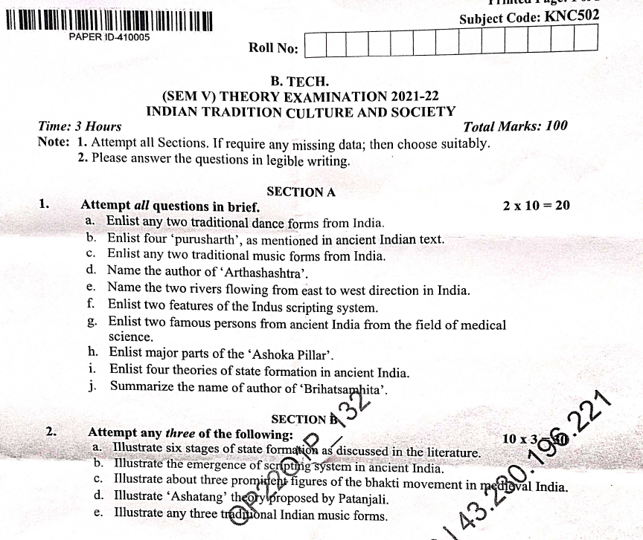
Old Question Papers

Slide 95
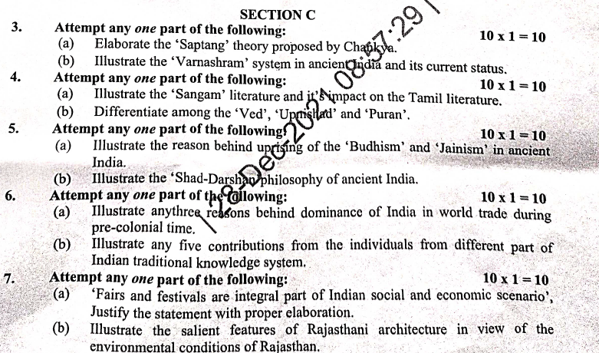
Old Question Papers

Slide 96
Expected Questions for University Exam
Explain Epigraphy in Ancient India.
Explain the contribution of India in Metallurgy to world in detail.
Explain the progress in Mathematics in Ancient time in India.
Explain the progress in Astronomy in Ancient time.
Explain the progress in Biology in India.

Slide 97
Recap of unit
In this unit, we learned about Astronomy in India, Chemistry in India, Mathematics in India.
We also studied, Physics in India, Agriculture in India, Medicine in India ,Metallurgy in India, Geography, Biology.
In this unit, we learned about Harappan Technologies, Water Management in India, Textile Technology in India.
We also studied, Writing Technology in India, Pyrotechnics in India Trade in Ancient India and India’s Dominance up to Pre-colonial Times.

Slide 98
References
V. Sivaramakrishna (Ed.), Cultural Heritage of India-Course Material, Bharatiya Vidya Bhavan, Mumbai, 5th Edition, 2014
S. Baliyan, Indian Art and Culture, Oxford University Press, India
https://indianexpress.com/article/research/a-crackling-history-of-fireworks-in-india-4890178/
https://artsandculture.google.com/partner/national-council-of-science-museums
https://artsandculture.google.com/exhibit/QQLyzPzKbMlEKg
Sharma, R.S., Aspects of Political Ideas and Institutions in Ancient India(fourth edition), Delhi, Motilal Banarsidass.
Thank You

